Slide 1
Reconstruction
The American pageant,
Chapter 22

Slide 3
Questions
The War is over, but…
How will the south rebuild?
How will freed blacks fare as free men and women?
How will the south be integrated to the union?
Who will lead the nation through reconstruction?

Slide 4
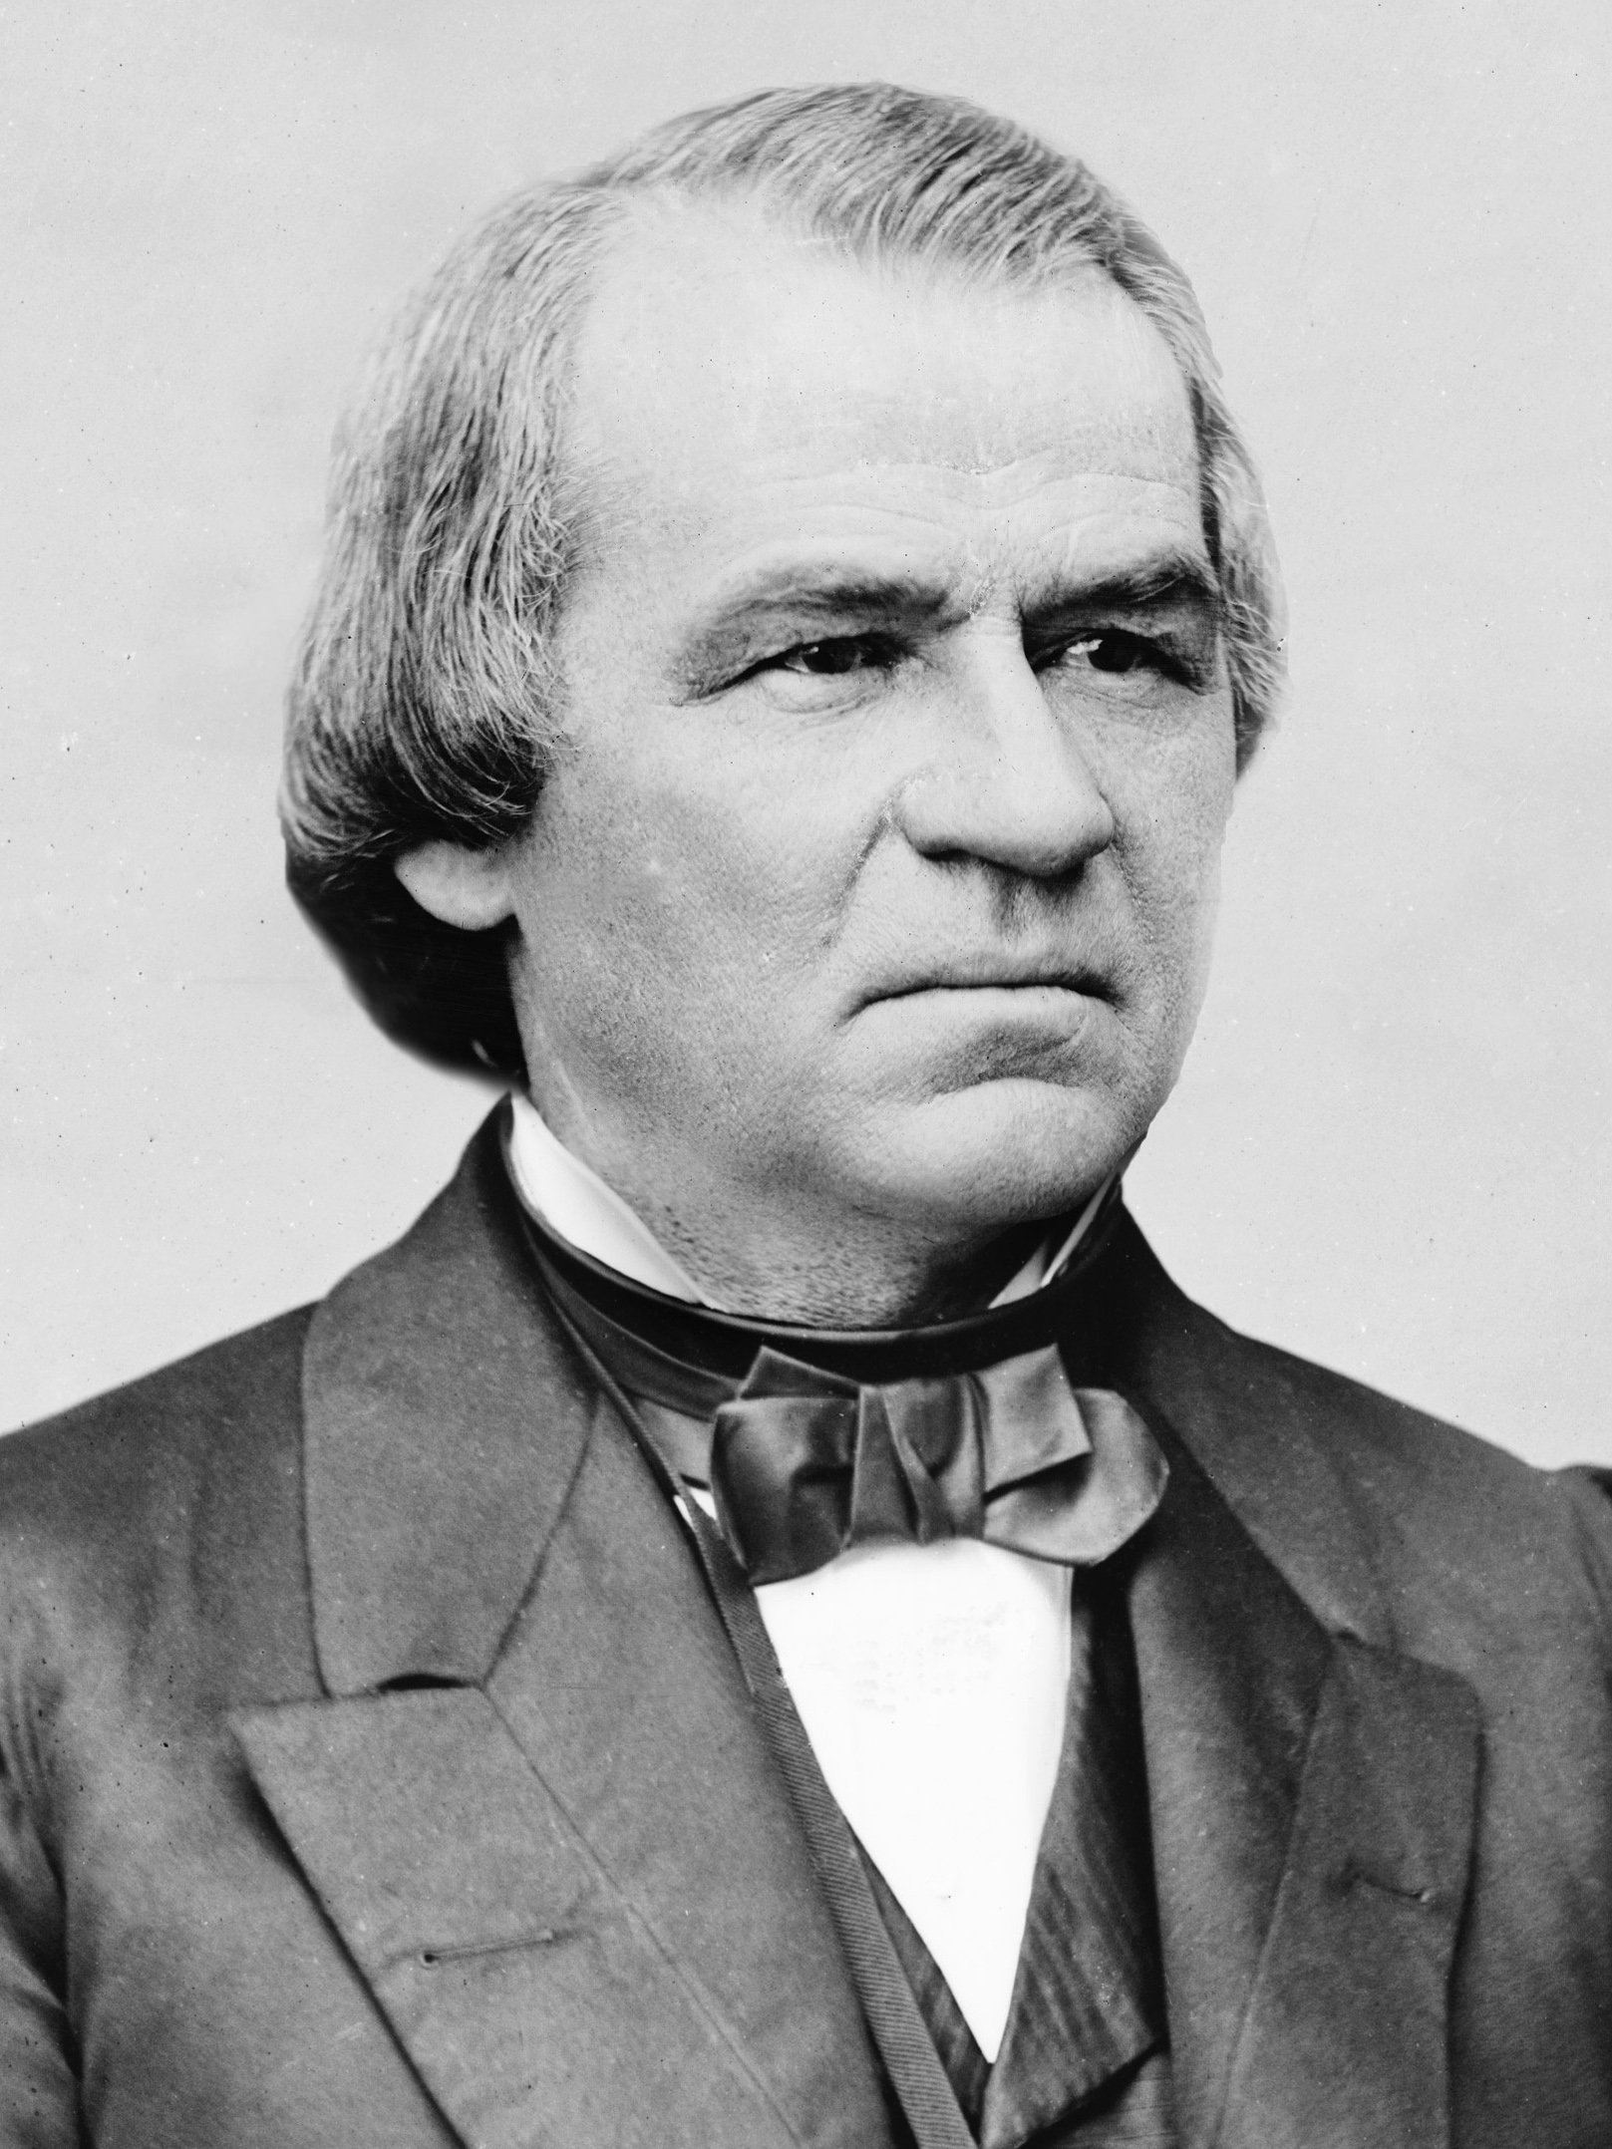
A Broken Unity
More Questions
Confederate leaders, treason
Confederate leaders pardoned by Johnson
South hurt by war
Economically, politically, mobility, agriculturally, livestock
South still defiant against the “damn Yankees”

Slide 5
What is freedom?
This, after the
13th Amendment
HAD PASSED!
Questions about freedom
Unequal distribution in south
Texas blacks fleeing to free soil hanged
Loyalty to masters—resistance to freedom
Betraying masters—embracing freedom
New freedom, new name, clothes, etc.—Mr., Mrs.
some rejected transportation
Education

Slide 6
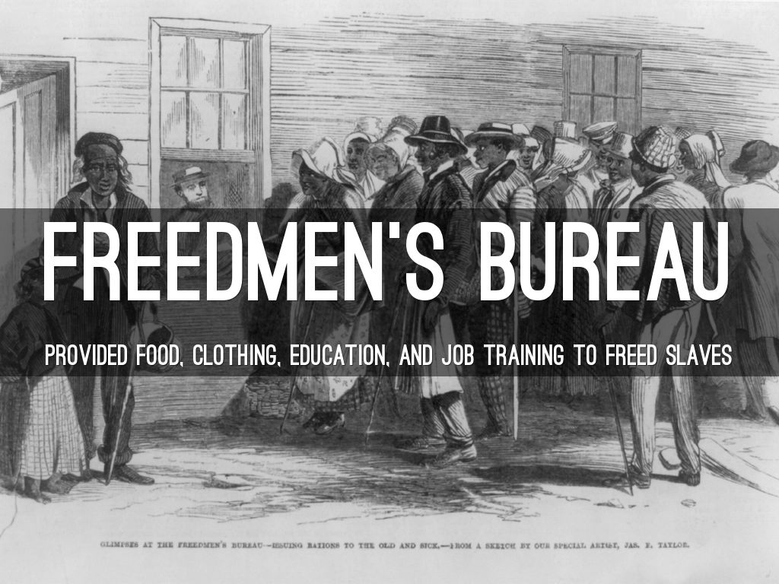
Freedmen’s Bureau
Blacks are free…now what?
No skills, no money, no shelter, no education
Congress est. freedmen’s bureau (1865)
Welfare agency
Provide clothes, medical care, education to freedmen and poor whites
Led by Oliver Howard
Greatest achievement—education (200,000 blacks learn to read)
Land—not so much
“Labor contracts” / “Sharecropping”

Slide 7
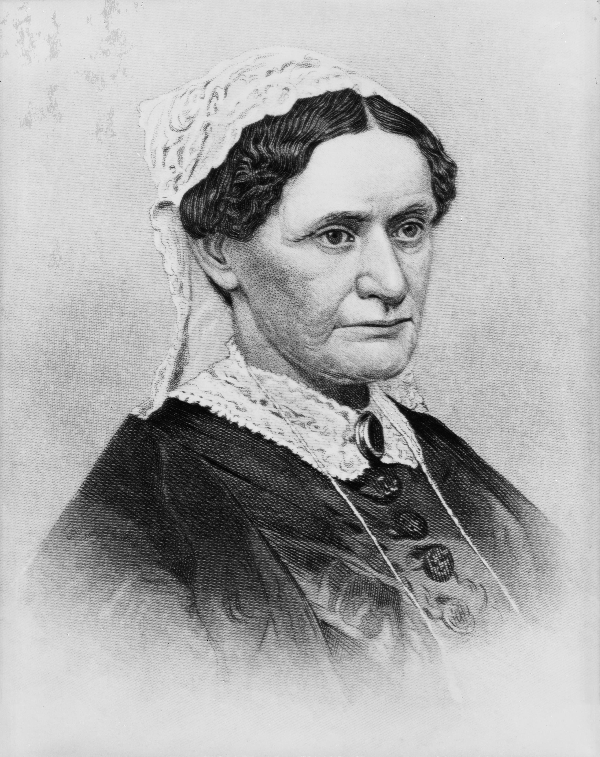
Andrew Johnson
Tennessee
Humble beginnings
Orphaned, never attended school
Tailor
Taught himself to read, wife taught him to write
Champion of poor whites; owned slaves
Refused to secede with his state
Ran with Lincoln as a war democrat
Champion of states’ rights and the constitution
Guilty by association; misfit; stubborn

Slide 9
Presidential reconstruction
Was secession legal?
NO!
1863—Lincoln
10% Reconstruction plan
states come back to union when 10% of electorate pledges allegiance to usa and to emancipation
Republican backlash
Wade Davis Bill
50% of electorate take oath of allegiance; stronger enforcement of emancipation
Pocket-vetoed by Lincoln
After assassination, Johnson goes along with Lincoln’s plan
Including—states had to ratify the 13th amendment
Johnson pardons confederate leaders
Division within Republican Party

Slide 10
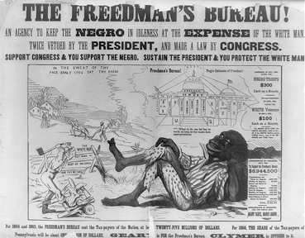
Black codes
Southern states readmitted—black codes
Johnson approved!
Limits on freed blacks—differed by state
Subservient labor force (legal slavery)
Rise of king cotton
Labor contracts—punishment for violating
Some rights (marriage)
BUT—can’t serve on juries, rent or lease land, vote
Sharecropping
North upset—why fight in vain?

Slide 11
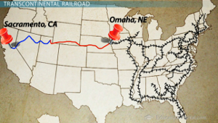
Congressional Reconstruction
As South is readmitted—so they are in congress
Rebels, leaders in the confederate army
Alexander Stephens—ex vice president of south → treason
TENSION!
Prior to South re-entering, congress (Union) passes:
Pacific railroad act—transcontinental railroad
Morrill tariff act—protective tariff on industry
Homestead act—westward expansion
Granting citizenship backfires politically against the north
3/5 → 5/5
Johnson—”the union is restored” –fear among the north!

Slide 12
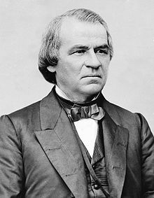
Johnson Versus Congress
Congress fearful of south, president
Johnson vetoes extension of freedmen’s bureau
Republicans pass
Civil rights bill—grants citizenship, strikes down black codes
Johnson vetoes, congress overturns
Congress dominant over president
14th amendment (1868)—south can’t undo civil rights bill!
Most of the south doesn’t ratify—why?
Those born in US are citizens of the US
Those born in US are afforded “equal protection”
Former confederate political leaders cannot hold political office
South will be punished if denying the right to vote to blacks

Slide 13
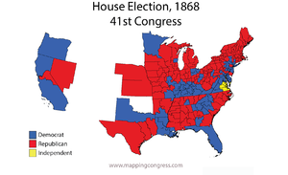
Johnson versus Congress
At the heart of it—
10% plans (most strict black codes)
Rejection of 14th Amendment
Rejection of Civil Rights Bill
Rejection of Freedmen’s Bureau

Slide 14
Republican Congress
“Veto-Proof” Congress—(R) still split on the South
Charles Sumner (S)
Black freedom, Racial equality
Thaddeus Stevens (H)
Black Freedom
13th Amendment
Quick-wit
Radical Republicans—keep south out!
Moderates disagree—states’ rights, self government

Slide 15
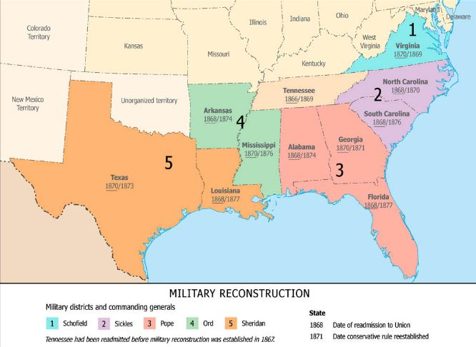
Reconstruction Act
Reconstruction Act—1867
Divides South into five military districts
Union General; 20,000 Union soldiers
Readmission for South IF
Ratify 14th Amendment
Full suffrage rights
Still no land rights
Fifteenth Amendment (1870)
Military Reconstruction
Martial Law
South follows rules long enough, then…
Redeemers

Slide 16
Reconstruction in South
Difference of Opinion
Offer vote to blacks gradually, with strings attached
14th Amendment does not secure the vote
Even the north didn’t allow blacks to vote
Union League
African Americans
Pro-Union
Education, black churches, grievances, militia recruitment
Women’s role

Slide 17
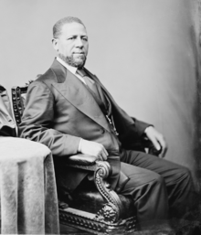
Reconstruction in the south
Blacks elected to state constitutional conventions
No governors—but growing presence in congress, local government
Former masters—upset
Scalawags (S), Carpetbaggers (N)
Accused of stealing from southern treasury
Costing the south their way of life
New focus on:
Public school, taxes, public works ,property rights for women
Government corruption

Slide 18
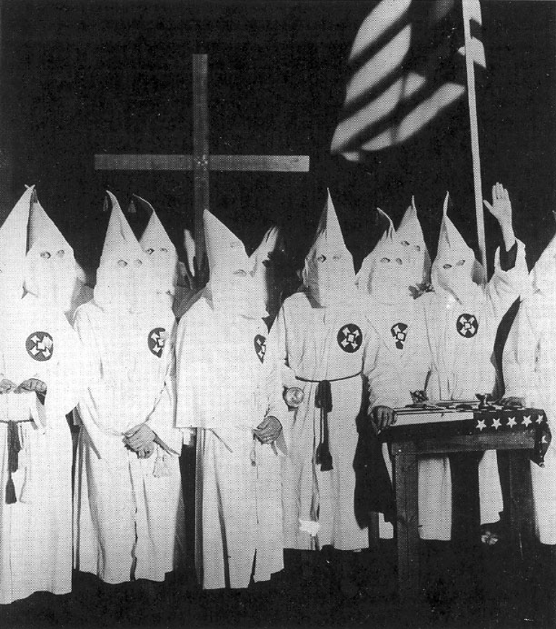
Ku Klux Klan
Southern resistance to “Radicals”
Resist black success
“Invisible Empire of the South” –KKK (1866)
Flogged, Mutilated, Hanged
200 victims in one day
Force Acts (1870, 1871)
Protective Acts for African Americans
KKK still operates

Slide 19
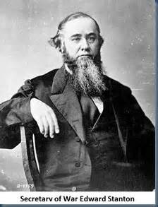
Johnson Impeached
Tenure of Office Act
Vetoed—overridden
Limits presidential power
President cannot remove his appointees without senate approval
Edward Stanton
Johnson removes Stanton from cabinet
House impeaches 126-47
“High treason”

Slide 20
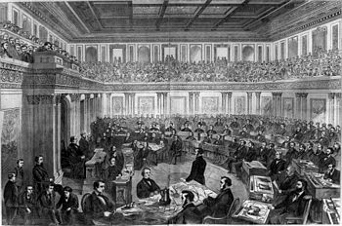
Johnson Acquitted
Johnson argues Tenure Act unconstitutional
Johnson acquitted (not guilty)—by one vote
Question on checks and balances
No vice president
Johnson agreed to stop obstructing (R) legislation
Not Guilty: 19
Guilty: 35

Slide 21
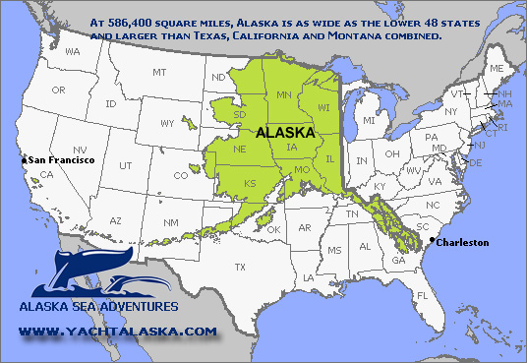
Alaska
Johnson’s greatest achievement
Alaska
Russia had no use for it
William Seward 1867
7.2 million
“Seward’s Folly,” “Seward’s Icebox”
Why buy?
Russia-pro union
Resources

